Slide 1
Human 2.0: Productivity

Slide 2
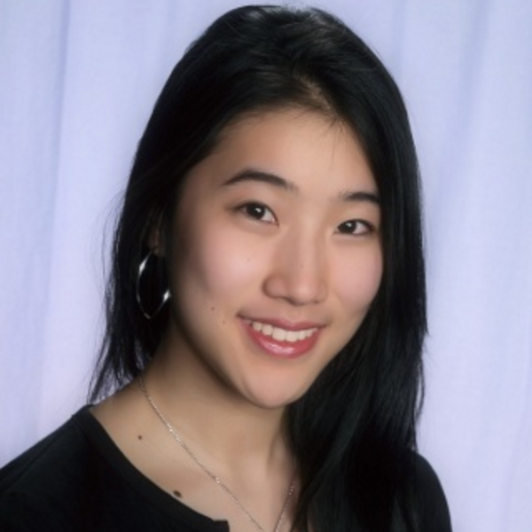
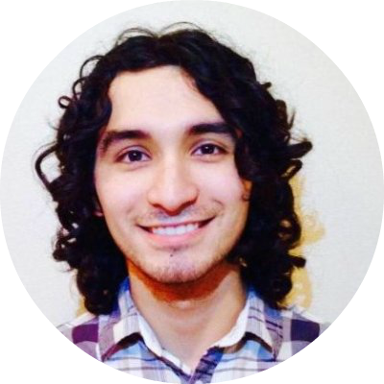
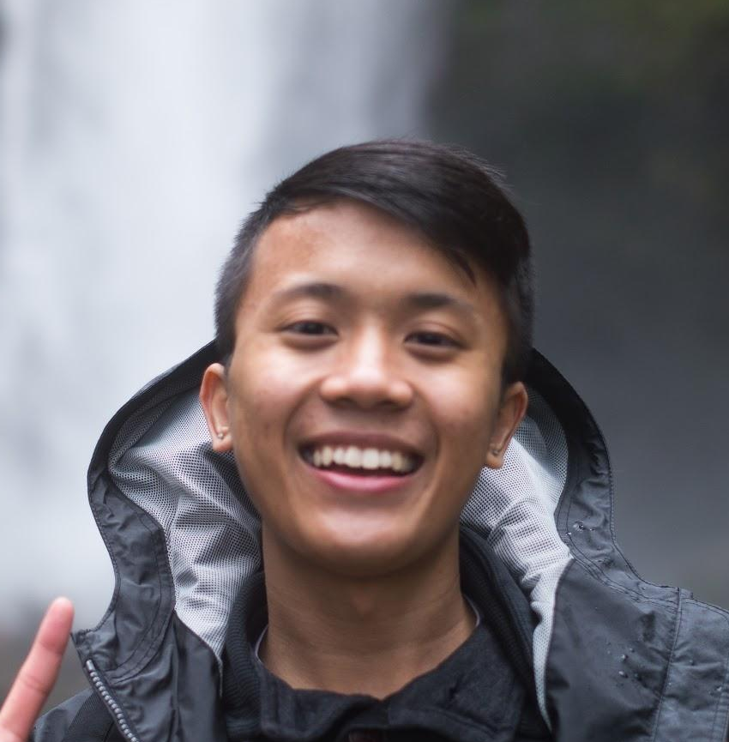
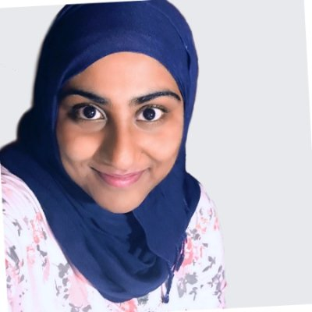
MEET THE TEAM
Ivan Salinas
SymSys
Crystal Zheng
MS&E and CS
Sidra Ijaz
CS
Jonathan Mao
CS

Slide 3
Problem Domain:
Human 2.0: Productivity

Slide 4
1.
NeedFinding Methodology

Slide 5
Users:
Extreme
Productivity tool power user
Has minimal free time
Juggles many activities or tasks
Highly productive
Average
Uses few organizational or productivity tools
Handles 1 or 2 main jobs or tasks
Has moderate amount of free time
Light
Has lots of free time or a flexible schedule
Hardly uses productivity or organization tools
Avoids using technology for productivity

Slide 6
Number of Interviewees:
9
Who? When? Where? Why? How?

Slide 7
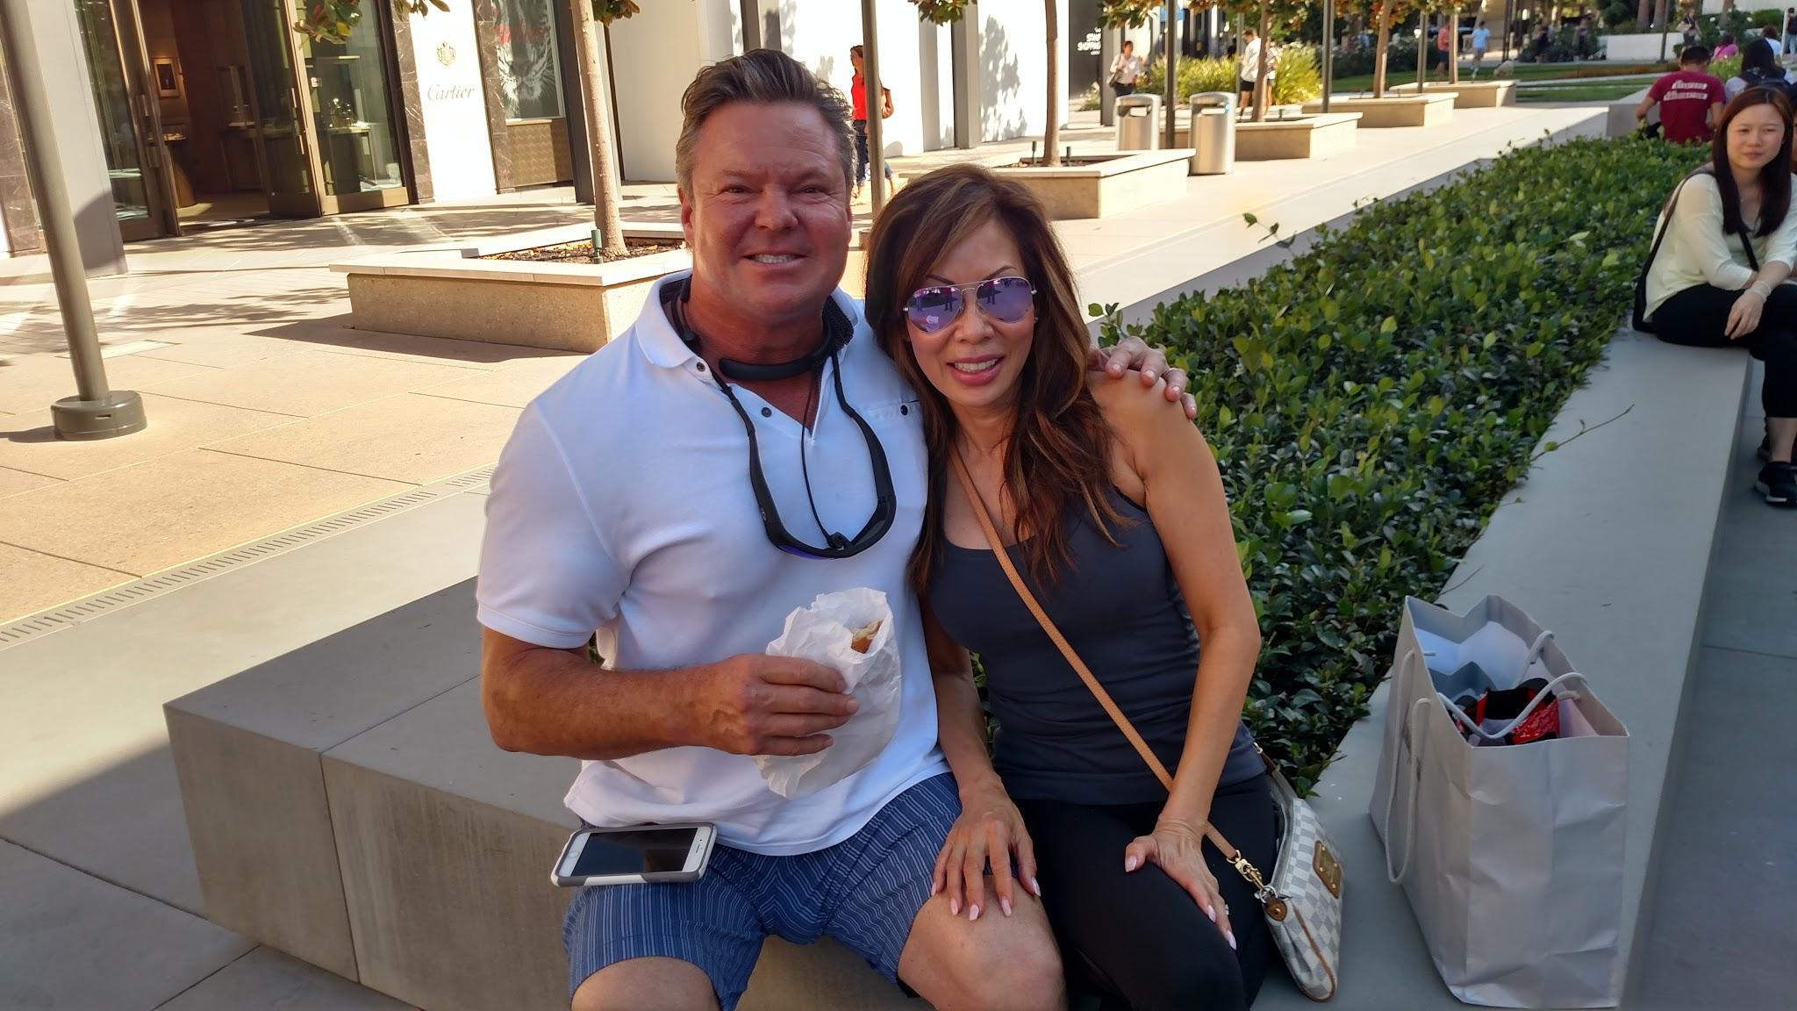
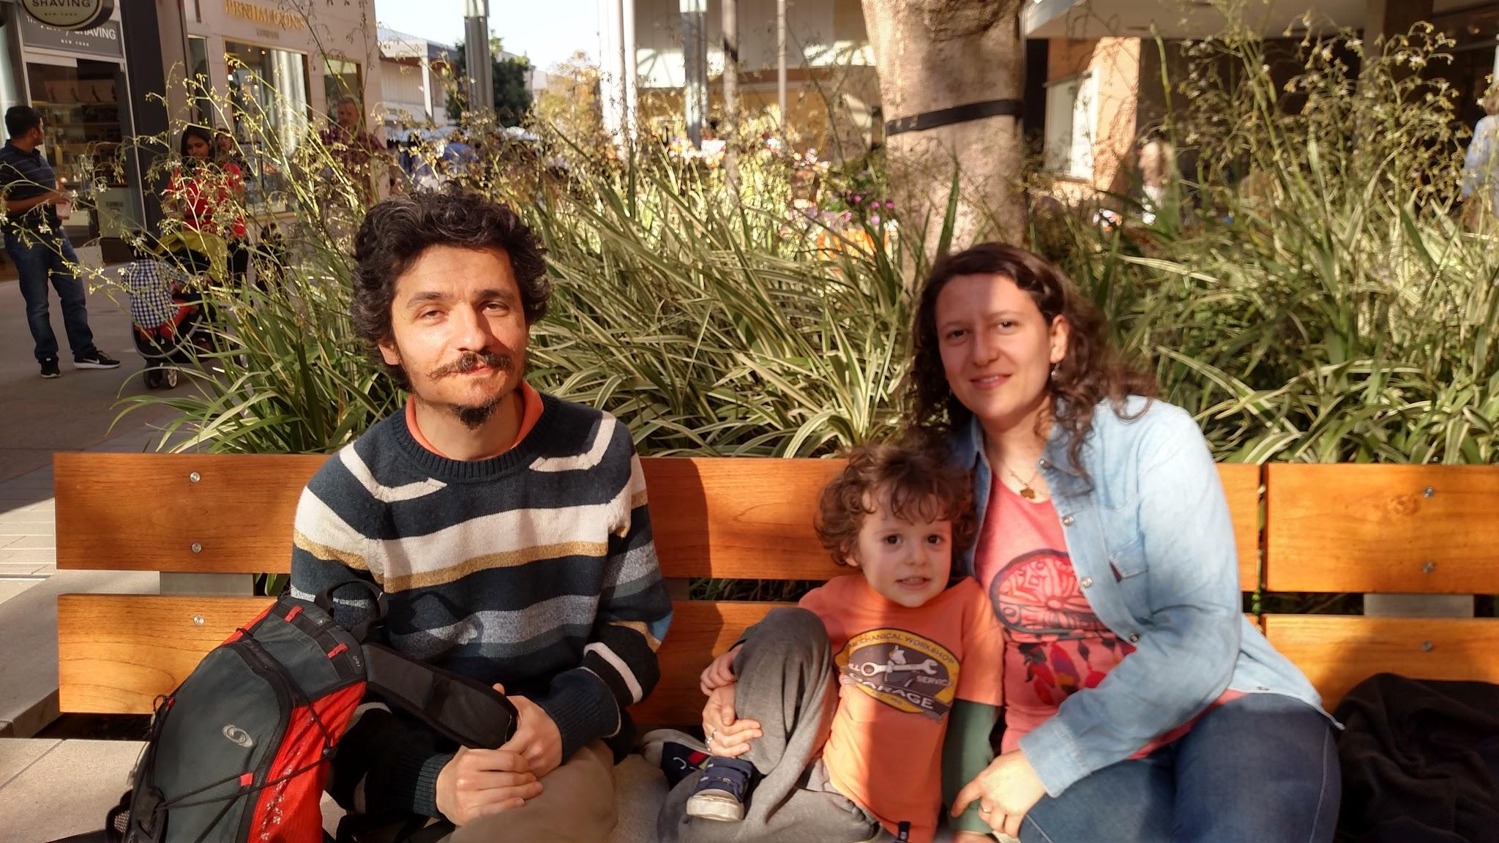
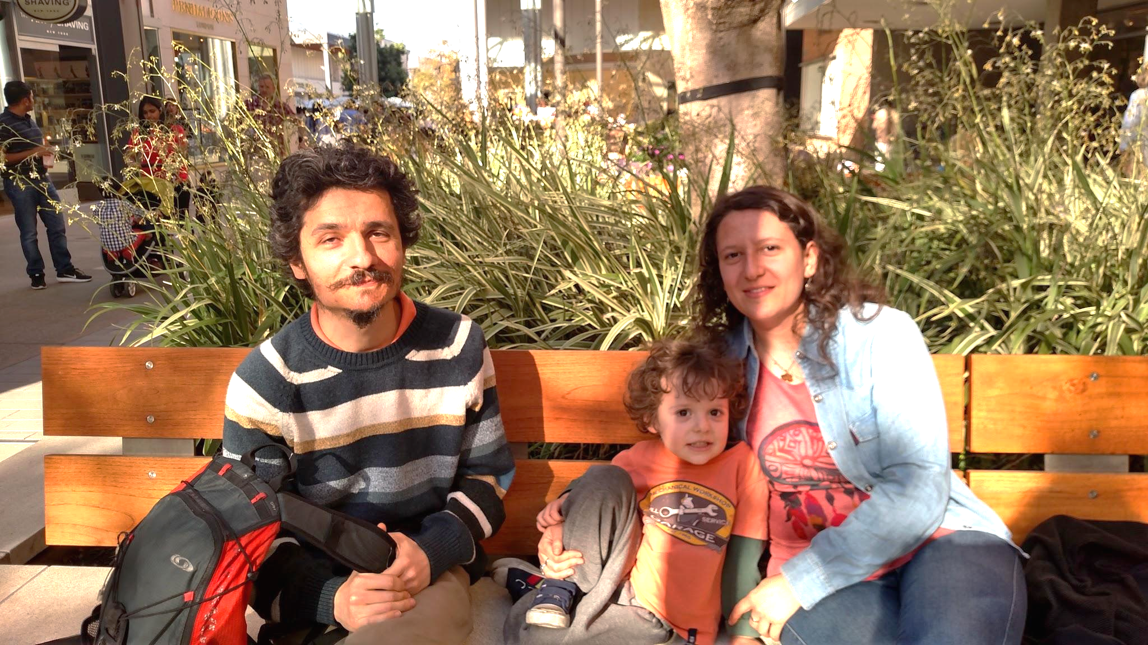
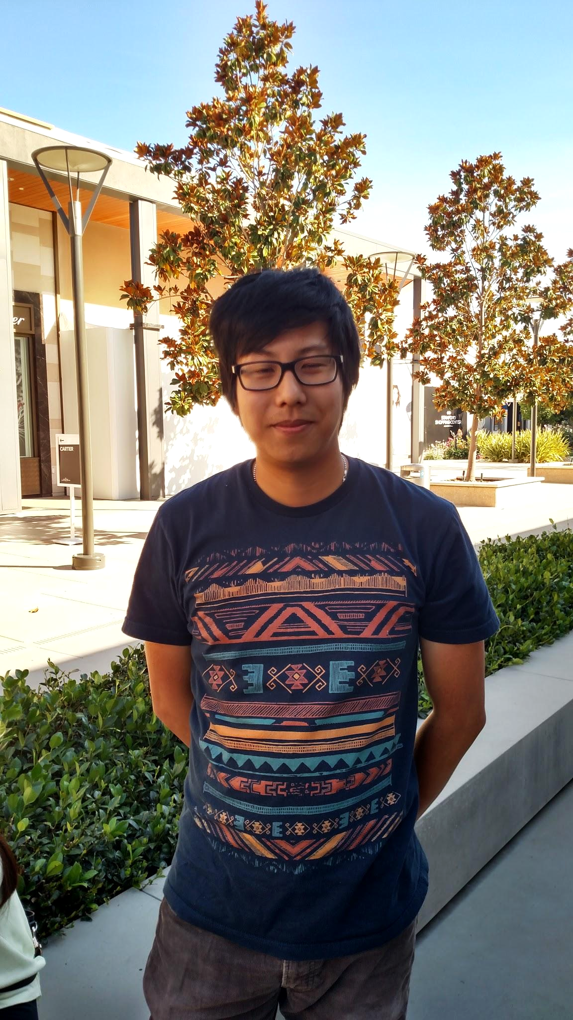
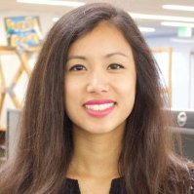
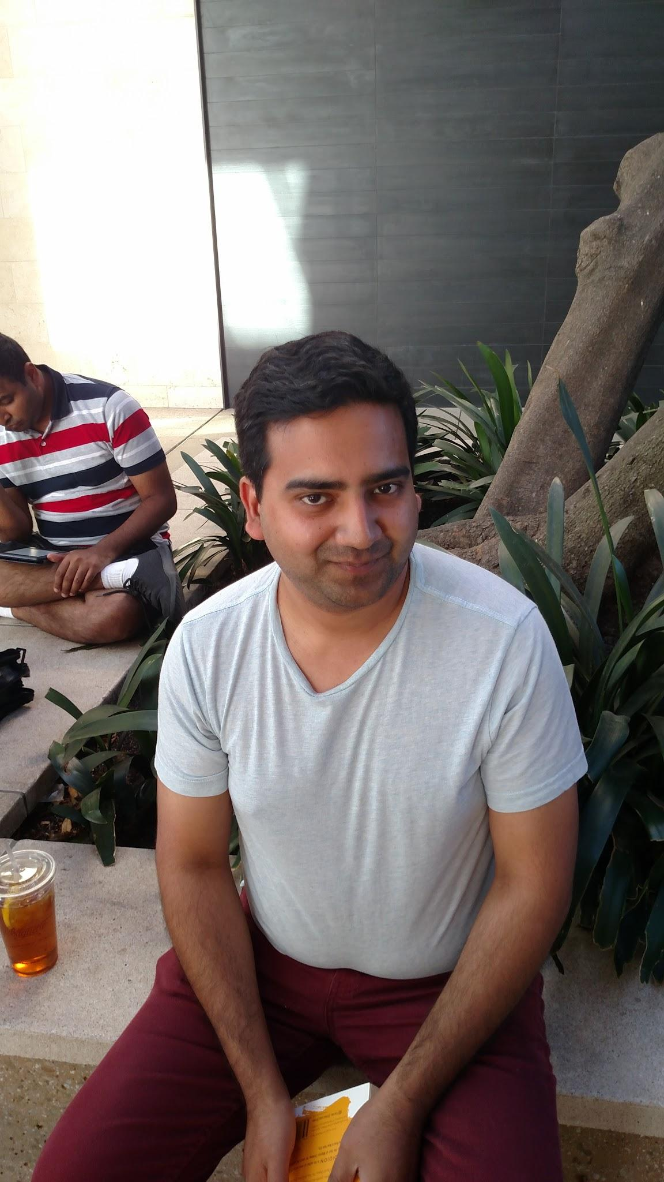
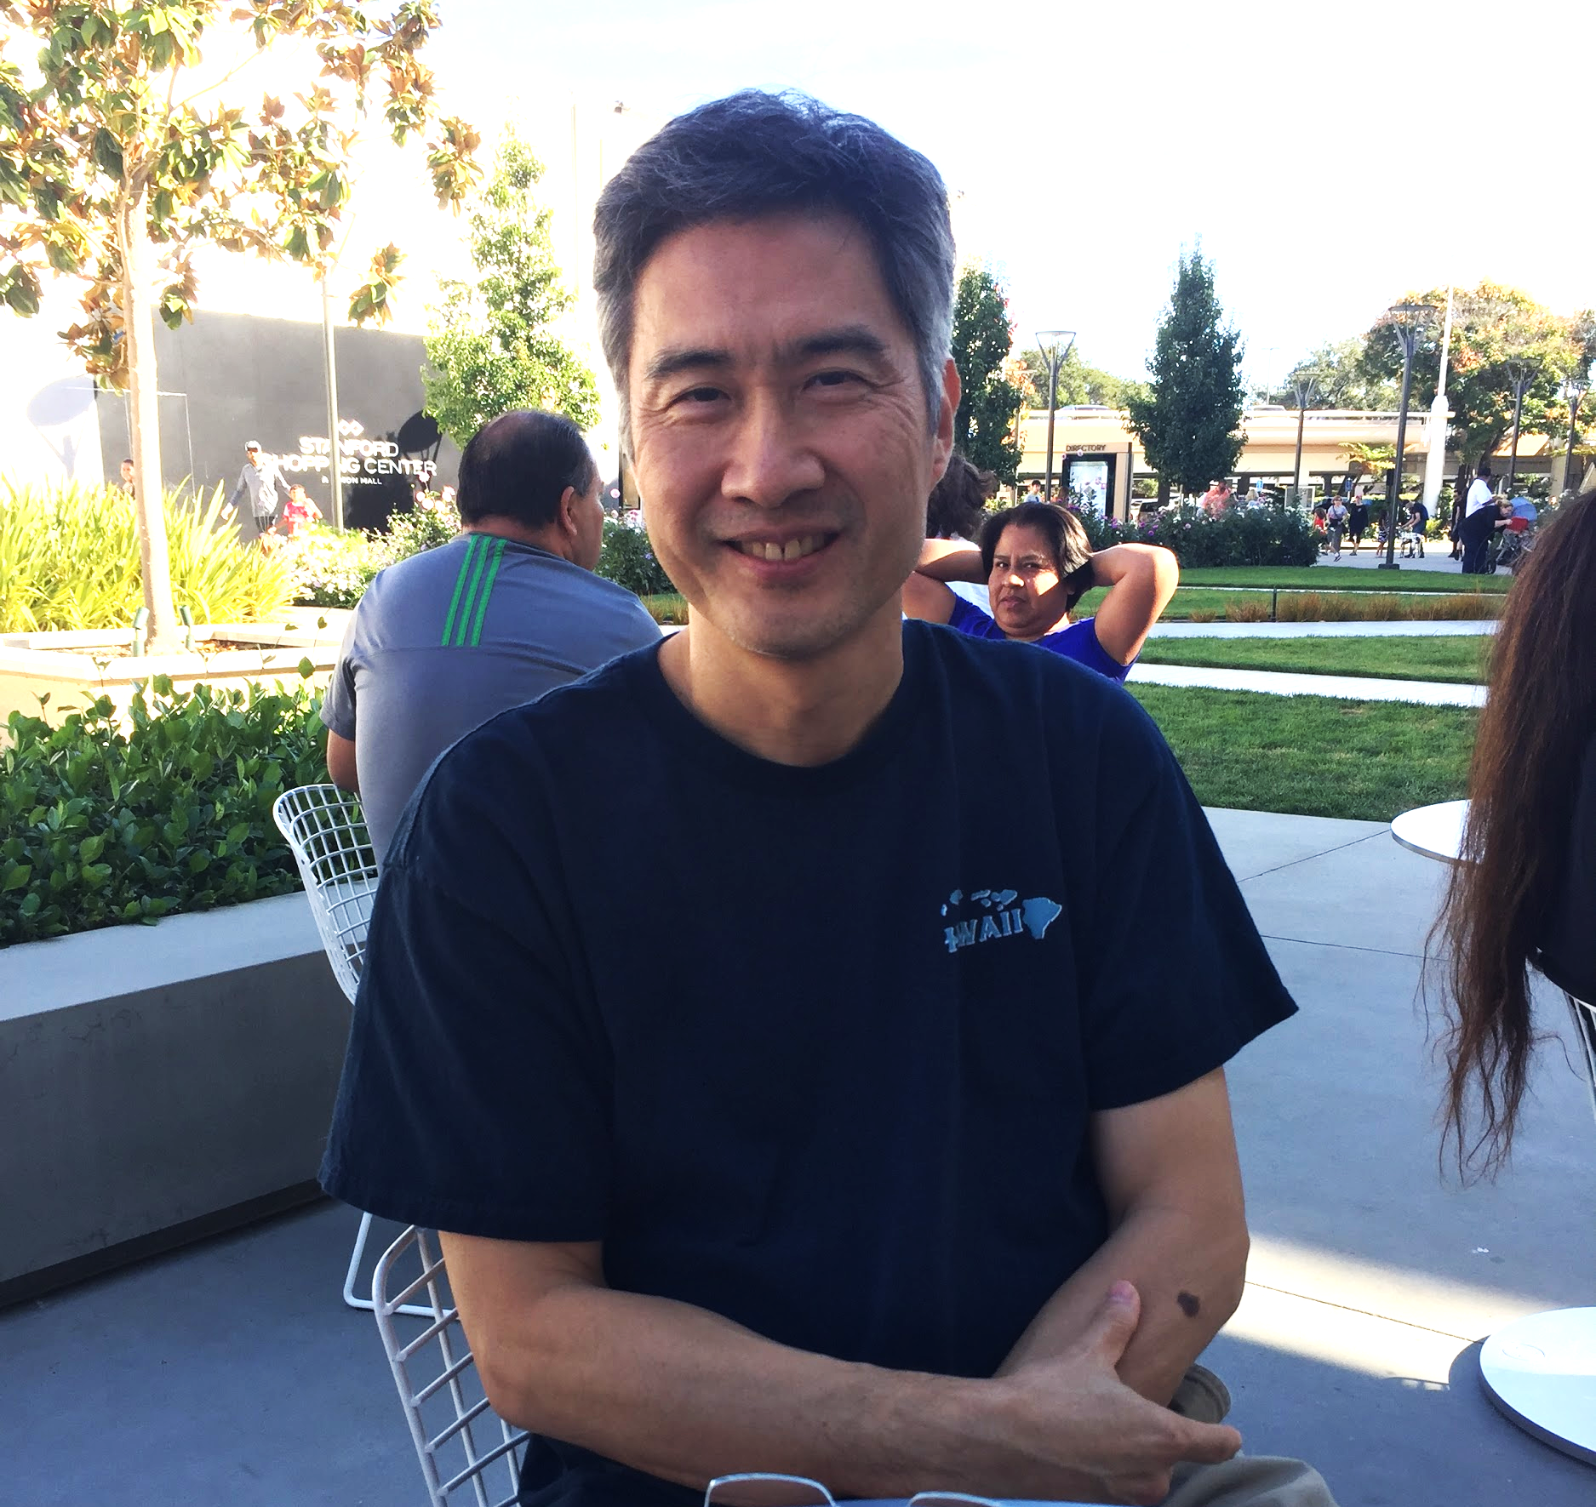
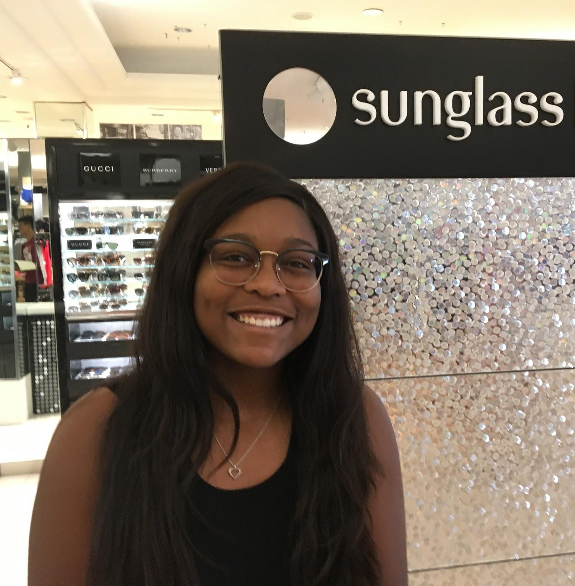
Our Interviewees:

Slide 8
Extreme User
Alana Garcia
Academic Skills Coach
Extremely familiar with productivity practices and technologies
Office at Lathrop Library
Jessica Rogers
Menlo College Student Athlete & Sales Associate
Juggles multiple tasks, little free time if ever, multiple calendars and planners
Behind Sunglass Hut counter

Slide 9
Average User
Martin
Software Engineer
Family and business keep him busy, but he uses few organizational tools
Relaxing on bench outside of Macy’s
Justin
Electrical Engineer
Uses calendar and Siri to handle organization and scheduling.
Dog watching at Stanford Shopping Center

Slide 10
Average User
Hajime
Software Engineer
Has used the same productivity tools for years.
Fiddling with phone outside of Apple Store
Abhilash
Science Researcher
Uses calendar and Siri to handle organization and scheduling.
Reading book outside La Baguette

Slide 11
Light User
Andrew
Real Estate Financing
Real estate calls 7 days a week, but he doesn’t use any organizational tools
Chatting on bench outside of Macy’s
Deborah
Writer/Stay-at-home mom
With young child, nuclear family, uses whiteboards and notepad
Relaxing on bench outside of Macy’s

Slide 12
A SAMPLE OF THE QUESTIONS WE ASKED
Tell me about a time you struggled with time management.
Could you describe for me, from start to finish, a typical day in your life?
Could you describe for us any tools you use to organize your time, stay productive, or focus?
Could you tell us about a moment when you were frustrated or struggled with staying organized or focused?
How do you stay focused or on track?
What activities would you like to spend more time on?
Could you describe what your ideal free day would be like and why?

Slide 13
2.
Interview Results
& Analysis

Slide 14
SAY
“It’s just hard because usually in my other classes, hw is due in the next class so that’s my routine. I definitely forget. that’s why I try to keep a really good planner”
“I’m busy,
7 days a week”
“I write; my main job is being a housewife, raising my child”
“Multitasking doesn’t exist, and there’s plenty of research out there to underscore that point”
“[OneNote] has been helpful for me for maybe 10 years”
“I sometimes find apps a little clunky and I don’t necessarily find any that synthesize everything that I want to do”
“Technology can’t even spell ‘that’s bad!’ Isn’t that bad?”
“I live in a small city... about an hour and a half away from here but depending on the traffic. It could get up to like 2.5”

Slide 15
DO
Commutes 3 times a week to San Francisco
Sticks to a routine, has multiple calendars
Uses 2 alerts on calendar in case he ignores the first one and forgets it
Uses social media blocking tools
Has to schedule time to rest
Uses to do list, pomodoro, and wunderlist
Breaks daunting tasks into the smallest possible unit
Procrastinates

Slide 16
Think
Dealing with software is tedious and unworthwhile
It’s important to be able to note down and look back on the past
The hardest thing about a task is starting the task
Software should be able to understand and think for you
Trusts technology more than herself
Believes in strictly sticking to a schedule and routine

Slide 17
Feel
Annoyed that software isn’t more intuitive
Feels rewarded by accomplishing small tasks
Indifferent to procrastination — it’s not a problem
Frustrated that commutes are long, unproductive
Reinvigorated by human interaction
Worried that they’ve forgotten to do something

Slide 18
Tensions & Contradictions
“I’m not a big technology guy, that’s why I delegate”
“Why can’t it integrate my thinking with the software? When I press the button, just work. AI!”
Although Alana coaches students on how to better manage their time and be more productive, she sometimes struggles with time management herself (which she finds kind of funny)
“Technology can never replace the feel of traditional pen and paper for me”
“The smartphone is becoming stupid”

Slide 19
Surprises
“I’m a firm believer in this. I don’t think there’s anything like a free day. I would just feel like I’m forgetting something”
“Multitasking doesn’t exist, and there’s plenty of research out there to underscore that point”
“Yes I procrastinate, I do most of my stuff last minute… I can’t think of anything to become more productive”
“The pressure I put on myself kept me going”

Slide 20
Quote(s):
“I can’t get all my calendars to completely sync together. On my phone, I can’t get my basketball schedule... if I put something on my laptop & iPad, it doesn’t go to my phone. So if I don’t have them with me it’s like I’m missing or forgetting something. I guess I wish technology was better I guess.”
Insight: People are very reliant on technology to remind them and they feel insecure without this technological reassurance
Need: Increased connectivity and migration between different organizational and productivity tools

Slide 21
Quote(s):
“Why can’t it integrate my thinking with the software? Like when I press the button, just work! AI! If I click something 20 times shouldn’t it remember it?”
Insight:
People think that technology has come along way, but it is not being implemented as it could be to better help daily activity
Need: More automation in technology tasks that are routinely repeated

Slide 22
Quote(s):
“I need to push myself to not work, sometimes I would like if I could set my reminders to remind myself to not work and take photos or play guitar”
Insight:
People often don’t make time to relax and enjoy themselves, as they’re constantly bombarded with other work that they may need to do
Need:
A system to remind people to focus on themselves and engage in activities for self-wellness or pleasure

Slide 23
Quote(s):
“I use tools to block social media… it’s my biggest distraction but [the tools] are still not very effective for me”
Insight:
Social media is a big time suck for many people and it’s very difficult to avoid its temptation
Need:
An effective way to deal with the distraction of social media

Slide 24
Conclusion/Summary: Key Takeaways
People would like increased convenience, reliability, and automation of technological tools
Many completely depend on technology to smoothly conduct business and daily activities
People would like ways to find time to take a break from productivity
The biggest block in productivity seems to be social media and internet
Some people are indifferent about their procrastination and lack of productivity
Others still prefer traditional paper and hand-written methods to keep themselves on top of things

Slide 25
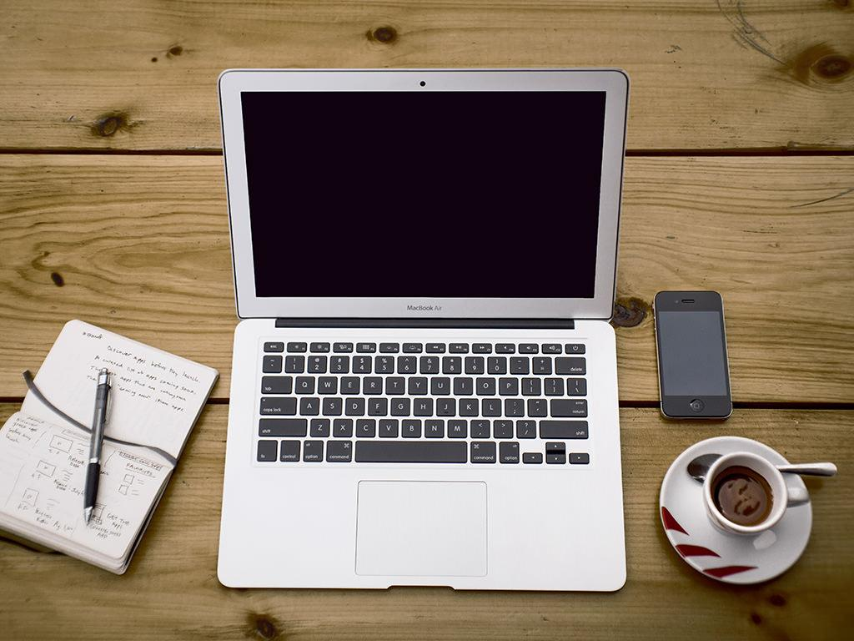
Thank You!
Any Questions?

Slide 26
3.
Compiled Empathy Map

Slide 27
SAY
Sometimes I use pomodoro, to do lists, and apps like wunderlist
I use tools to block off social media sites, but they’re not the most efficient
Social media tends to be the biggest distraction
I don’t have a huge traffic of emails
I used apps to keep track of time
We’ll advise students to add in things like meals and sleep, self care items that take up time but don’t necessarily show up in someone’s calendar so that people understand that when they see a lot of vacancies in their schedule that there are things taking them up and that they don’t get a skewed view of how much time they do and do not hav
I would like a smart system that reads your emails, and sets reminders for you
[My job] keeps me hella busy
How come they can’t make little things about software easier, more intuitive?
I like the feeling of writing, but maybe speech to text transcription would speed the process of writing
I had to push myself to not work and do things I liked

Slide 28
DO
He uses reminders on paper and on his iphone
Delegates software usage authority to employees
Uses calendar and apple watch for productivity
Charges his electric car daily, sets timer at 5 pm but sometimes meetings impede that
Writes poems and science fiction
Schedules drafts and deadlines, although they are movable
Asks customers to email reminders if they wanted something, otherwise he forgets
Helps students implement time-management/productivity methods and students see improvement over time
Structures errands, or tasks she’s procrastinating on, even on her off time.
Watches Netflix, tries new restaurants, enjoys traveling
Creates presentations for clients
Practices martial arts ~2 times a week
Good at multitasking, jumping in and out of convos to talk to customers

Slide 29
Think
Dealing with software is tedious and unworthwhile
Technology is difficult to learn; why can’t it just know
It would be nice to have a smart system that reads your emails, and sets reminders for you
Technology could make writing faster, but paper and pen feel better to use
Having a schedule and specific goals makes it easier to avoid distractions and enjoy free time outside work
Trusts technology more than herself
Believes in strictly sticking to a schedule and routine
Procrastination is a problem everyone struggles with
The hardest part of getting menial tasks done is starting; once you’re in the middle, it’s easier to keep going than it is to get started.
The hardest thing about a task is starting the task
It’s important to be able to note down and look back on the past
Software should be able to understand and think for you
Wants software that learns from every day motions
Wants multiple alert in case you ignore the first one

Slide 30
Feel
Annoyed that software isn’t more intuitive
Disappointed in the lack of implementation of technology even though it has a lot of potential,
Comforted by working with pen and paper
Passionate about having a process for executing a task is good
Frustrated that it’s hard to stay on track with career, family and personal hobbies
Overworked from running his own business and setting his own schedule
Indifferent to becoming a non-procrastinator, does not see it as a problem
Feels something is missing without technology
Frustrated that commutes are long, unproductive
Distrusting of herself to remember things

